Slide 1
ROBOTIC FUNDAMENTALS (UMFM4X-15-M)
Parallel Robots II

Slide 2

Previously on
Parallel mechanisms have more than one kinematic chains
Mobility is calculated by the Grubler-Kutzbach equation
Do not forget about the local-mobility and over-constrains
Questions?

Slide 3
Today’s Lecture
Workspace
Loop closure Vector chain
Kinematics

Slide 4
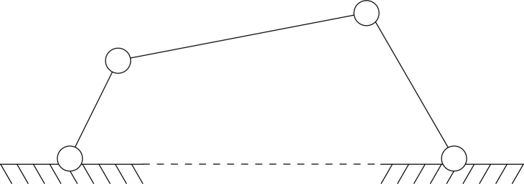
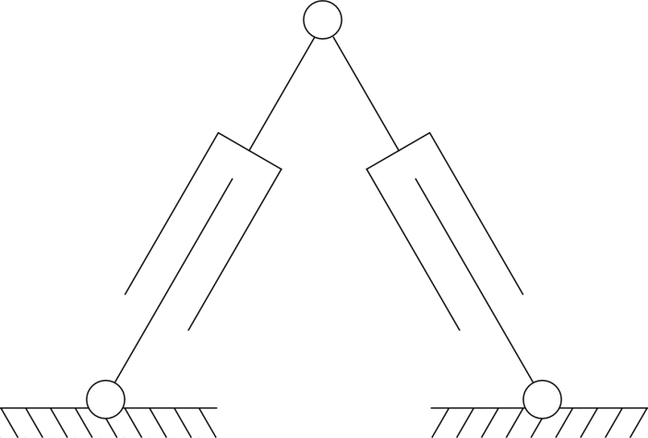
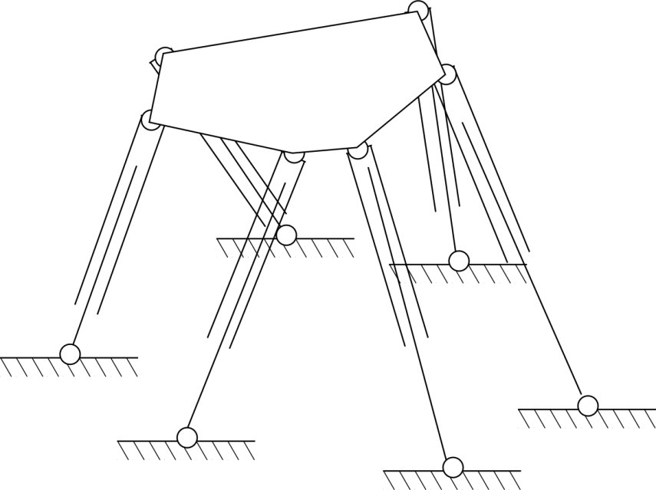
Mechanisms of the week
Four-bar linkage
2RPR
Steward Platform

Slide 5
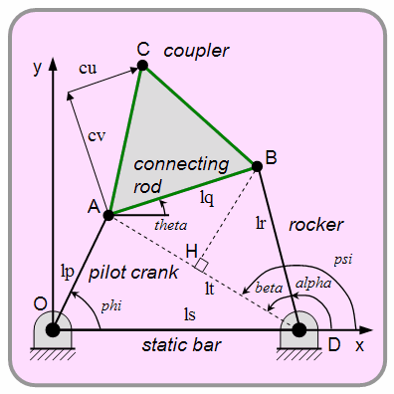
Four bar linkage
The four-bar linkage is a versatile planar mechanism, used extensively in articulated systems:
For the Ackerman steering in cars
For car and bike suspensions.
For hydraulic tail lifts
In hydraulic machinery
In industrial automation
For garage lifting doors.
For engine hoods.
For locking pliers.
Notes:
As we have previously seen, it has 1 degree of freedom. This means that only one input is required to make the linkage move. If designed properly, the instant centre never becomes coincident with a joint and it will move in a deterministic manner. Because of its simplicity, and perhaps also because of the rapid increase in design complexity suffered by linkages with more than 4 bars, the 4-bar linkage is one of the most commonly used linkages.

Slide 6
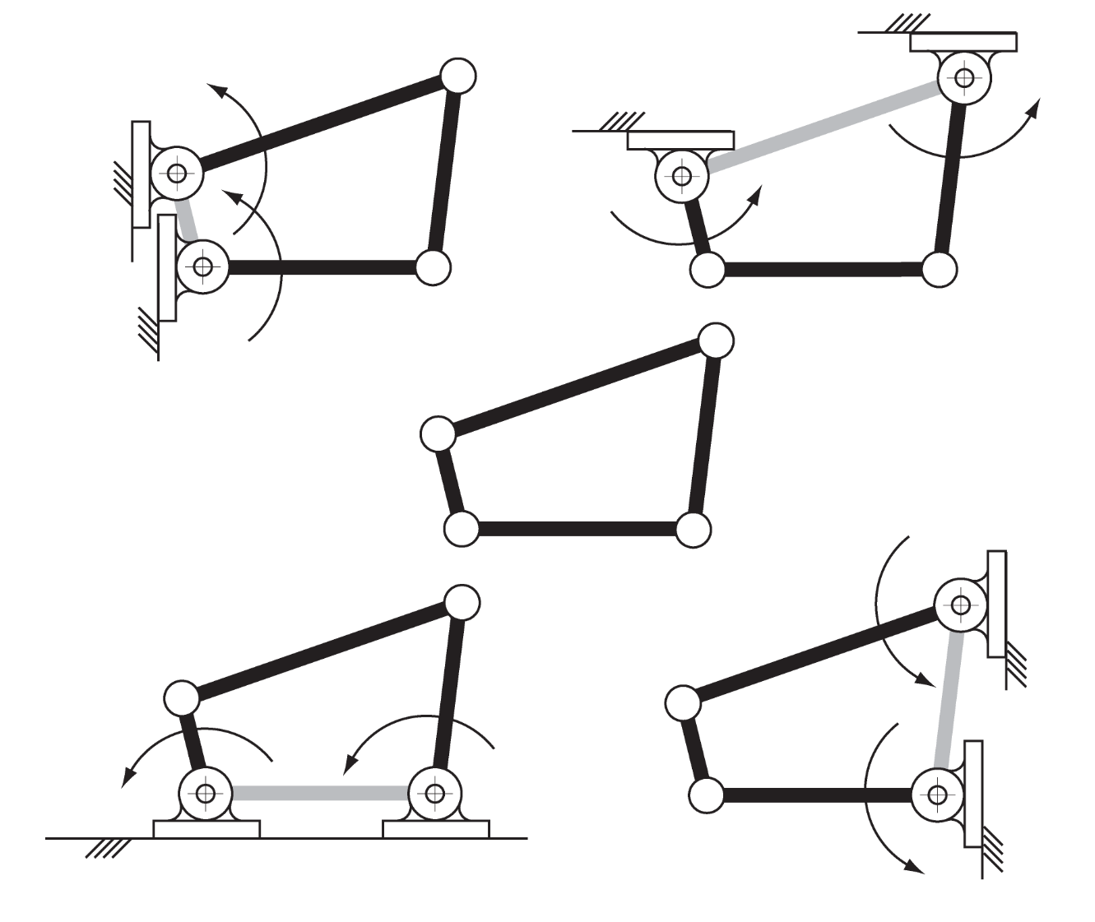
Four bar linkages
Notes:
There are the four inversions of the 4R linkage. They are also called crank-rocker, rocker-crank, double rocker and drag-link mechanisms, to describe how they move.

Slide 7
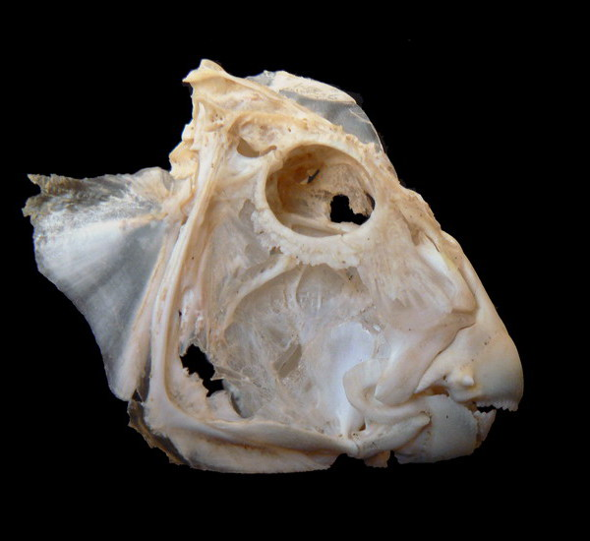
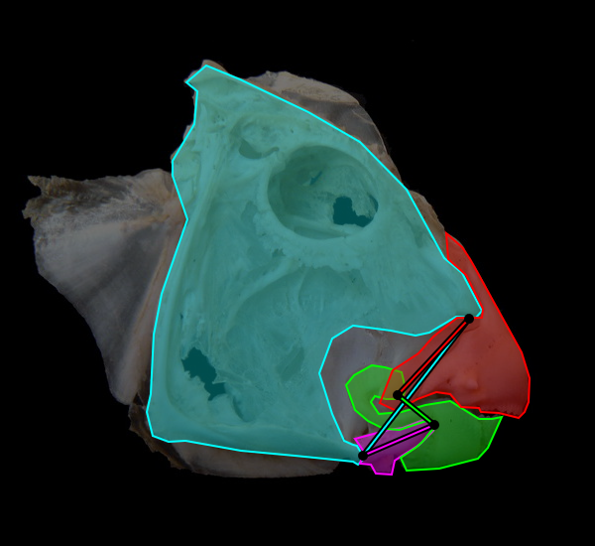

Four bar linkage - Example: Parrotfish jaw
Muller, M. "A novel classification of planar four-bar linkages and its application to the mechanical analysis of animal systems." Philosophical Transactions of the Royal Society of London B: Biological Sciences 351, no. 1340 (1996): 689-720.

Slide 8
Workspace

Slide 9
Workspace
The workspace of a robot is defined as the set of all end effector configurations which can be reached by some choice of joint coordinates.
The reachable locations of an end-effector are dependent on its orientation, specifically for parallel robots.
Notes:
Parallel manipulators’ motion can be restricted by: mechanical limits of passive joints, self collision between the struts, actuators limitations and singularities.

Slide 10
Workspaces – Refined for Parallel
Reachable Workspace:
All the locations of EE that may be reached with at least one orientation
Dexterous Workspace:
Constant orientation workspace: all possible points that can be reached at a given orientation
Orientation workspace: all possible orientations at a given location
Notes:
Parallel manipulators’ motion can be restricted by: mechanical limits of passive joints, self collision between the struts, actuators limitations and singularities.

Slide 11
Workspace calculation
Geometric approach: Deduce all possible locations of the EE (WS) from the constraints of each leg.
Use minimum and maximum of each strut actuator to define the working volume. Take all physical constraints into account.
Discretisation approach: The WS is covered by a grid of nodes. The boundary is established by the set of nodes where the close neighbours do not belong to the WS. Disadvantages: sampling step of the grid limits accuracy, computationally intensive.
Numerical approach: uses Jacobian matrix but has been illustrated only for 6UPS robot*.
*Bohigas, Oriol, Montserrat Manubens, and Lluís Ros. "A Linear Relaxation Method for Computing Workspace Slices of the Stewart Platform." Journal of Mechanisms and Robotics 5, no. 1 (2013): 011005.

Slide 12
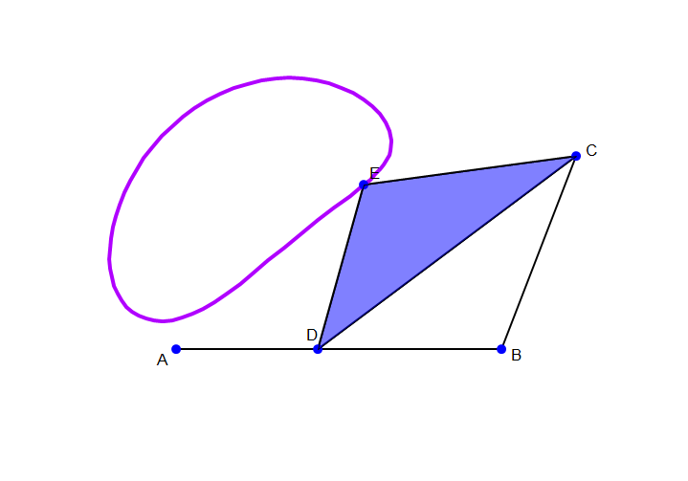
Workspace – Four-bar linkage
One trajectory of a specific geometry
Depends on the design/task we want
Notes:
What analytical methods of calculating the workspace can you think of?

Slide 13
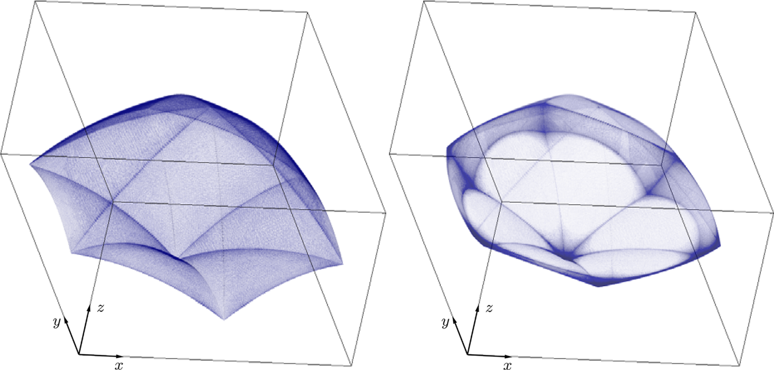
Workspace – Steward Platform
Complex
Mathematically derived
Notes:
Resulting workspaces when taking into account only active-joint-limit constraints (left) or active- and passive-joint-limit constraints simultaneously (right).

Slide 14
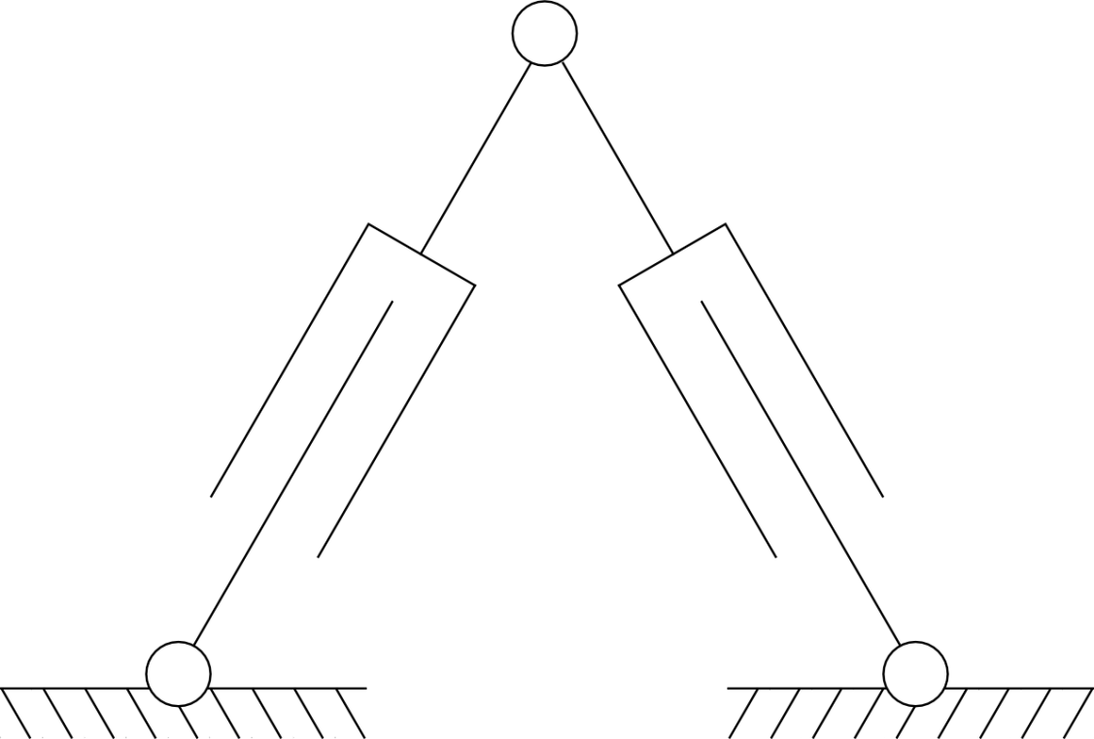
Workspace – 2RPR
?
Geometric calculation
p₁
p₂
Notes:
The prismatic joints have a maximum and minimum limit.

Slide 15
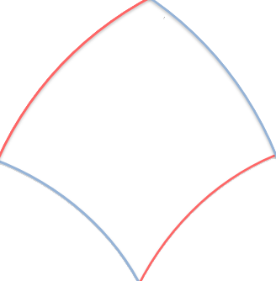
Workspace – 2RPR
p₁
p₂
Notes:
The prismatic joints have a maximum and minimum limit. This is what roughly the workspace looks like when the prismatic joints move between these limits.
Instead of a diamond with straight sides, the workspace has curved sides due to the revolute joints.

Slide 16
IK - Loop Closure vector chain

Slide 17
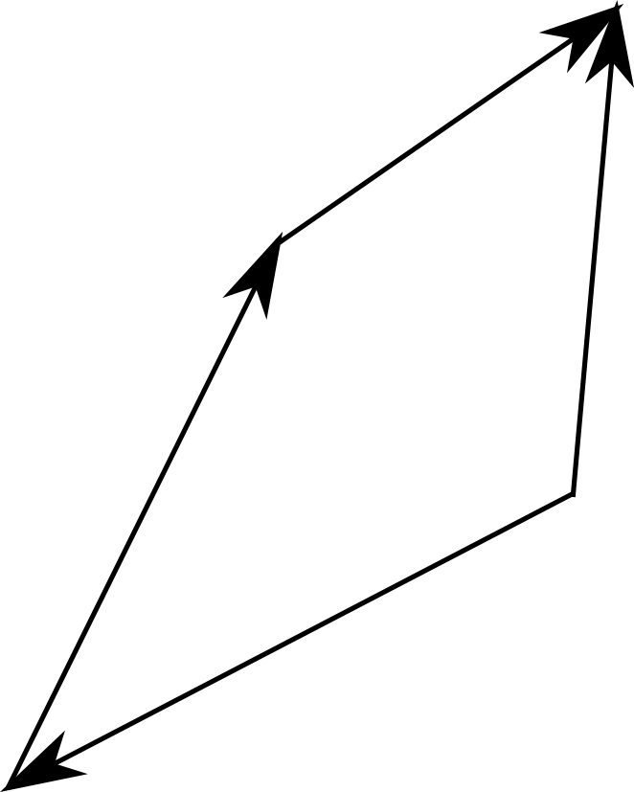
Loop Closure Vector Chain
Use vectors to connect the different points of the kinematic chain and formulate the motion equations

Slide 18
Loop Closure Vector Chain
Use vectors to connect the different points of the kinematic chain and formulate the motion equations
E
M
W
S
Notes:
WE: basically the input to the IK (position of the end effector E w.r.t. the world frame W.
WS: known by design, as S is the base of the robot(‘s leg), so it is given by the dimensions of the base.
SM, ME: function of the joint variables. This is what we need to find using vector analysis

Slide 19
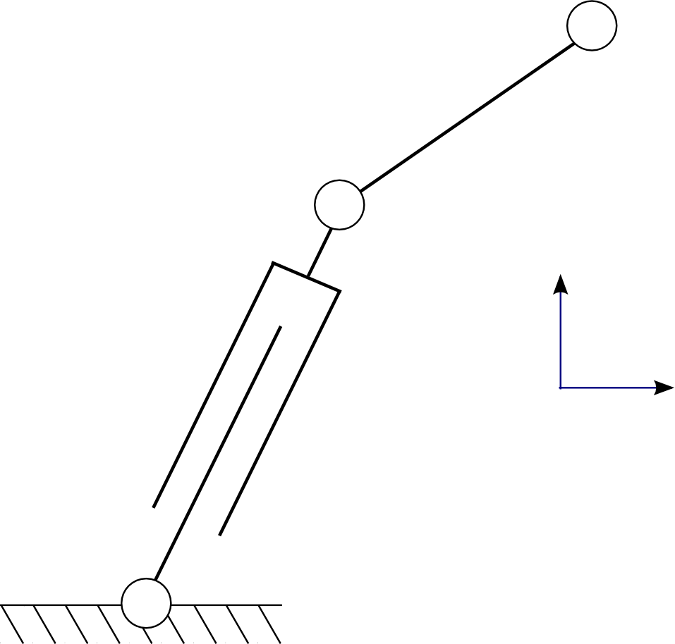
Loop Closure Vector Chain – Example in Single Leg
One leg of a parallel robot with one prismatic and one active revolute joint
θ
WCS
p

Slide 20
Loop Closure Vector Chain – Example: Sample Leg with 2 joints
One leg of a parallel robot with one prismatic and one active revolute joint
E
θ
M
p
W
S

Slide 21
From Vector chain to IK
Based on the Vector chain we can establish the relationships for the Inverse Kinematics
Following the vectors of the chain we can identify the required Transformation Matrices
More interesting for IK because we know the coordinates of the end-effector, and we know the geometry of the mechanism.
We do it consecutively for all legs.

Slide 22
What about FK?
40 different solutions to direct kinematics which can be obtained mathematically solving the equation by a solution of nonlinear equations like the Newton-Raphson method
Dietmaier, Peter. "The Stewart-Gough platform of general geometry can have 40 real postures." Advances in Robot Kinematics: Analysis and Control. Springer Netherlands, 1998. 7-16.

Slide 23
What about FK?
Solve the problem using Interval Analysis, i.e. investigate the function that gives the FK solution for the manipulator
Merlet, J-P. "Solving the forward kinematics of a Gough-type parallel manipulator with interval analysis." The International Journal of robotics research 23.3 (2004): 221-235.

Slide 24
What about FK?
Use the IK, in a method that uses a closed-loop Jacobian algorithm with the Newton-Raphson method to efficiently identify the desired solution
Abo-Shanab, Roshdy Foaad. "An Efficient Method for Solving the Direct Kinematics of Parallel Manipulators Following a Trajectory." Journal of Automation and Control Engineering Vol 2.3 (2014).

Slide 25
Summary
The workspace of Parallel robots can be calculated geometrically or numerically.
IK is performed first by vector chain and then by defining magnitude and attitude of vector
FK of parallel robots are computationally complicated

Slide 26
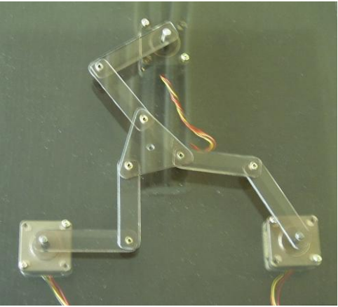
3RRR – Planar Robot
Notes:
M = 3

Slide 27

From Vector chain to IK – Example: Steward Platform

Slide 28
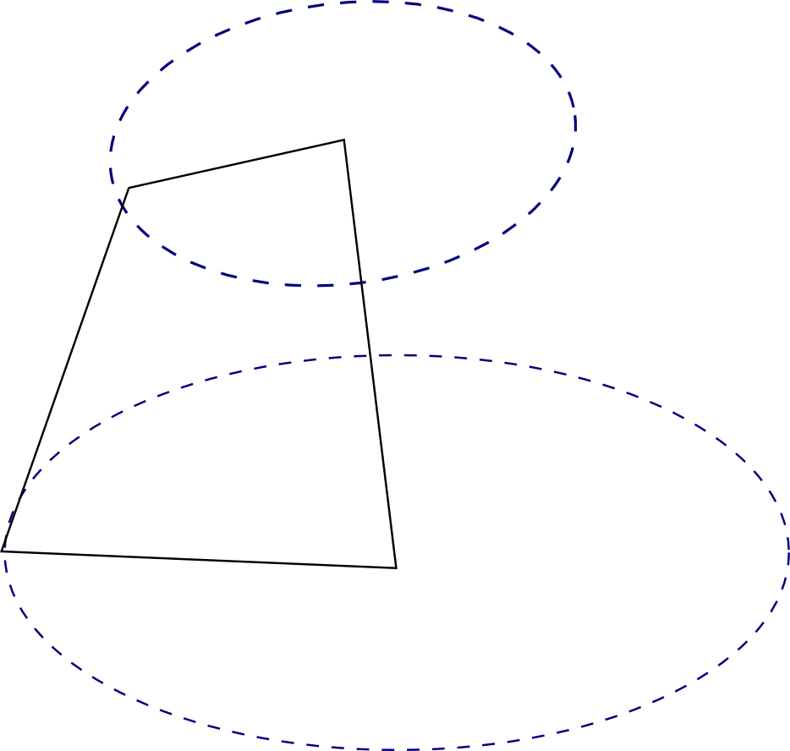
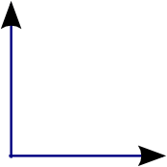
From Vector chain to IK – Example: Steward Platform
We know the Centre (C) of the platform and we need p_{1.}
C
PP₁
p₁
PB₁
WCS
Notes:
P1 prismatic joint of one leg
PP: point on platform
PB: point on base

Slide 29
From Vector chain to IK – Numerical Example: 2RPR
Assume the depicted mechanism, what will be p₁ and p₂ for movement of the tip to (-1,5)?
p₁
p₂
WCS
2m
2m

Slide 30
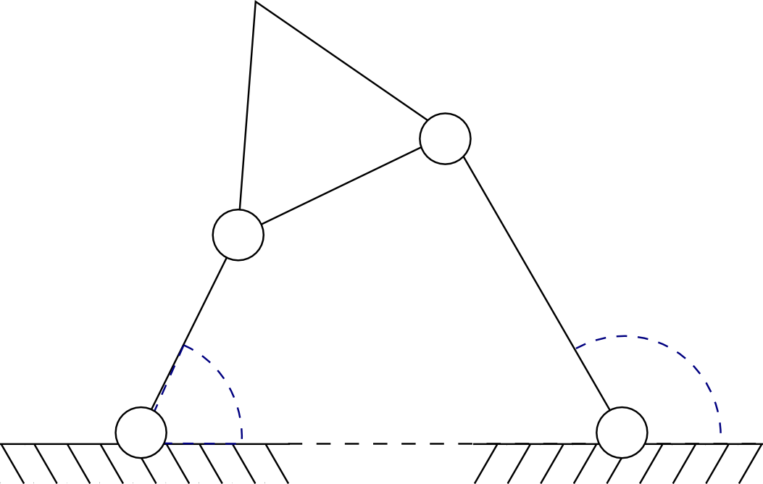
From Vector chain to IK – Example: Four-Bar linkage
Simple four-bar link with platform
C
PP₂
PP₁
WCS
l₂
l₁
θ₁
θ₂
PB₁
PB₂

